Slide 1
TIME SERIES AND USER INTERFACE CUSTOMISATION IN GOOGLE EARTH ENGINE Ernest Opoku-Kwarteng eopoku-kwarteng@ug.edu.gh Center for Remote Sensing and Geographic Information Services (CERSGIS)

Slide 2
Graphical User Interface
The Google Earth Engine Code Editor is a Graphical User Interface (GUI) on its own
While the base elements (map, task pane, etc.) cannot be altered new functionality can be added to the GUI
Three different classes of elements can be added to the existing GUI:
Widgets
Panels
Events

Slide 3
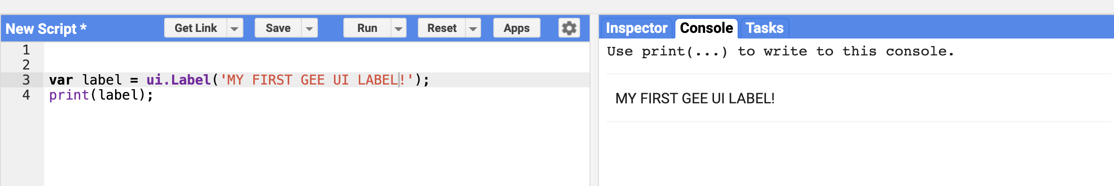
Widgets
Widgets include buttons, checkboxes, sliders, textboxes and selection menus
There are a variety of widgets for building or customizing UIs.
Widgets can only be added to a panel once
ui.Label
Labels are simply areas in which text is displayed. For example, the following code prints a label:

Slide 4
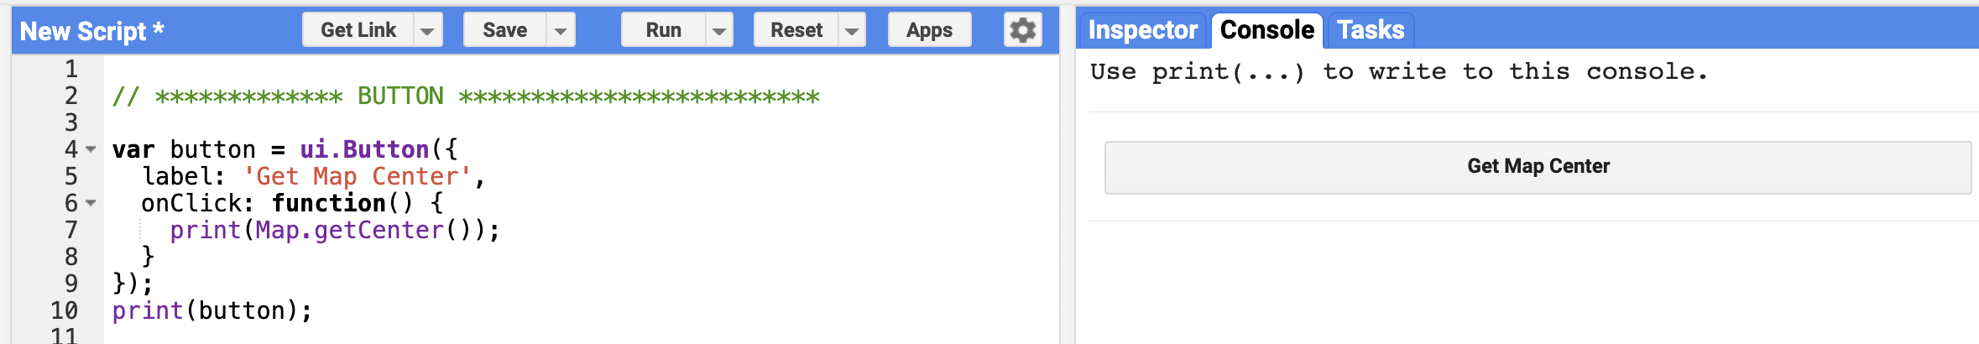
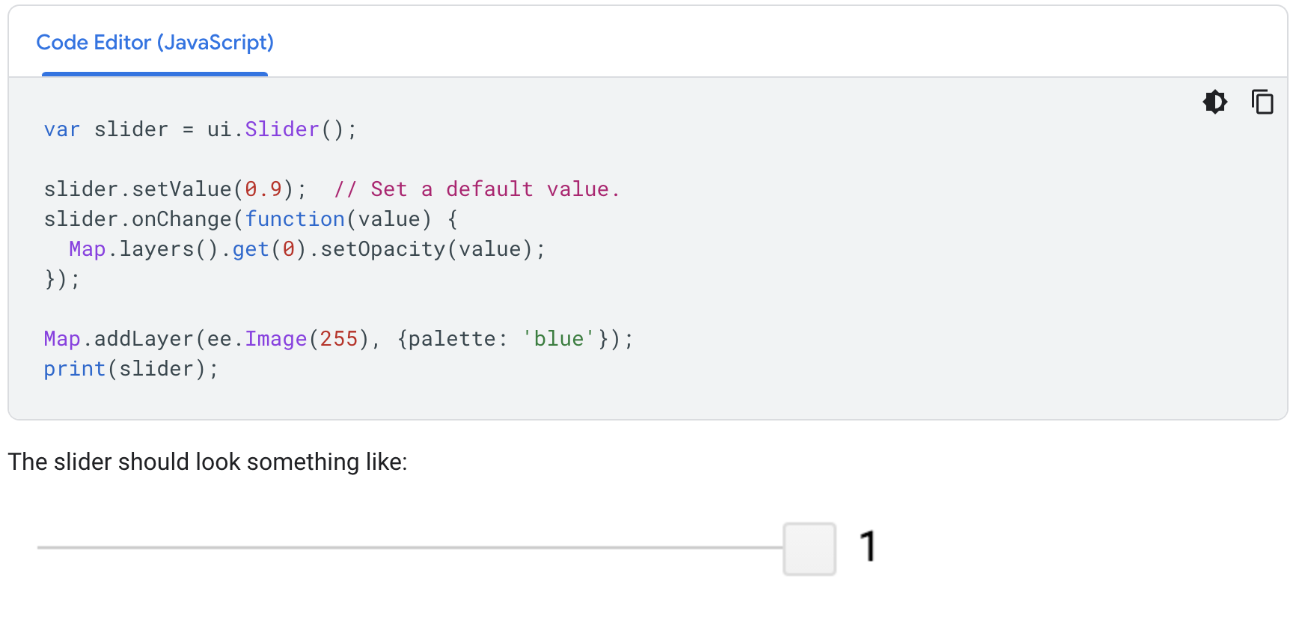
ui.Button
A button is an interactive UI widget that can be clicked. You can specify a function to be called when a user clicks the button
ui.Slider
A slider is a widget that lets a user adjust a slider to get a number within the slider range
Run Example

Slide 5
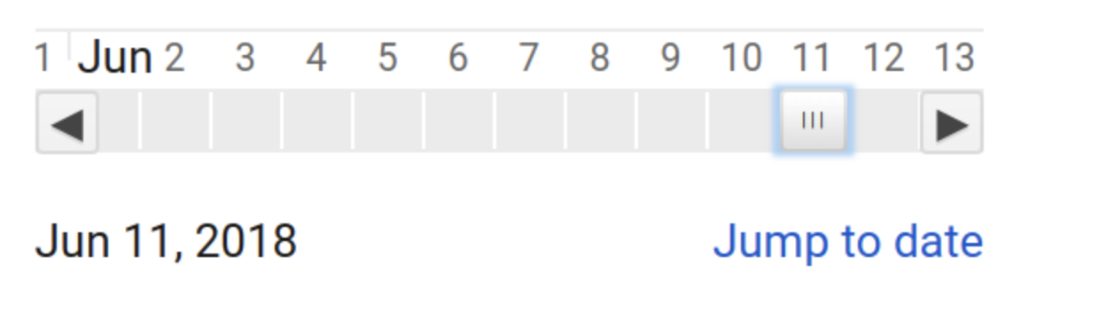
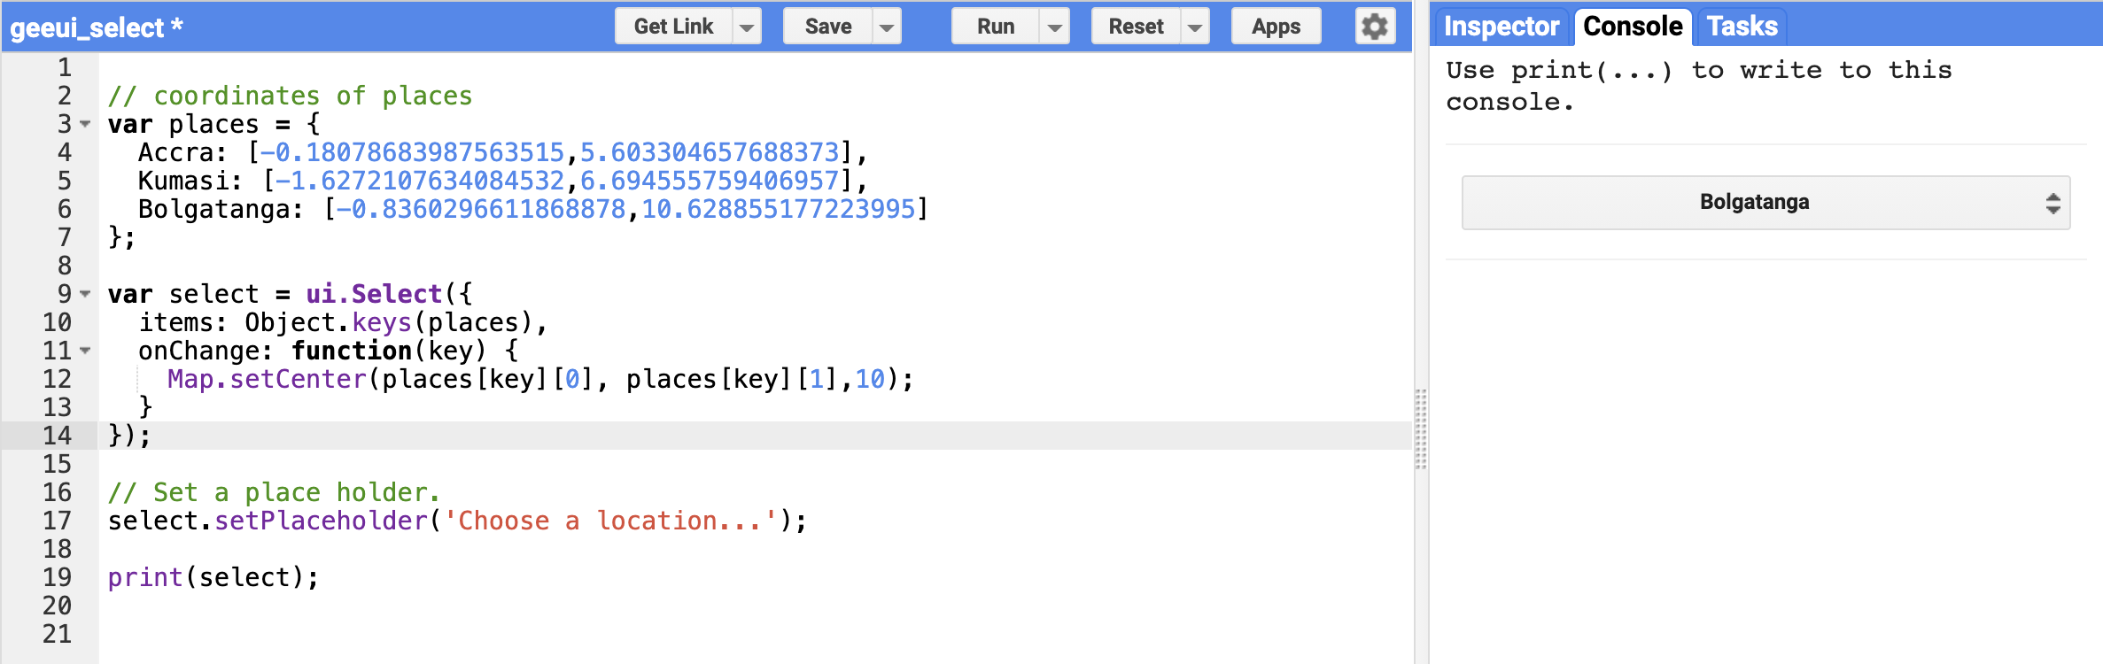
ui.DateSlider
The DateSlider widget is like the Slider widget, but handles dates explicitly
ui.Select
The select widget represents a drop-down menu of choices from which the user can choose one
Run Example

Slide 6
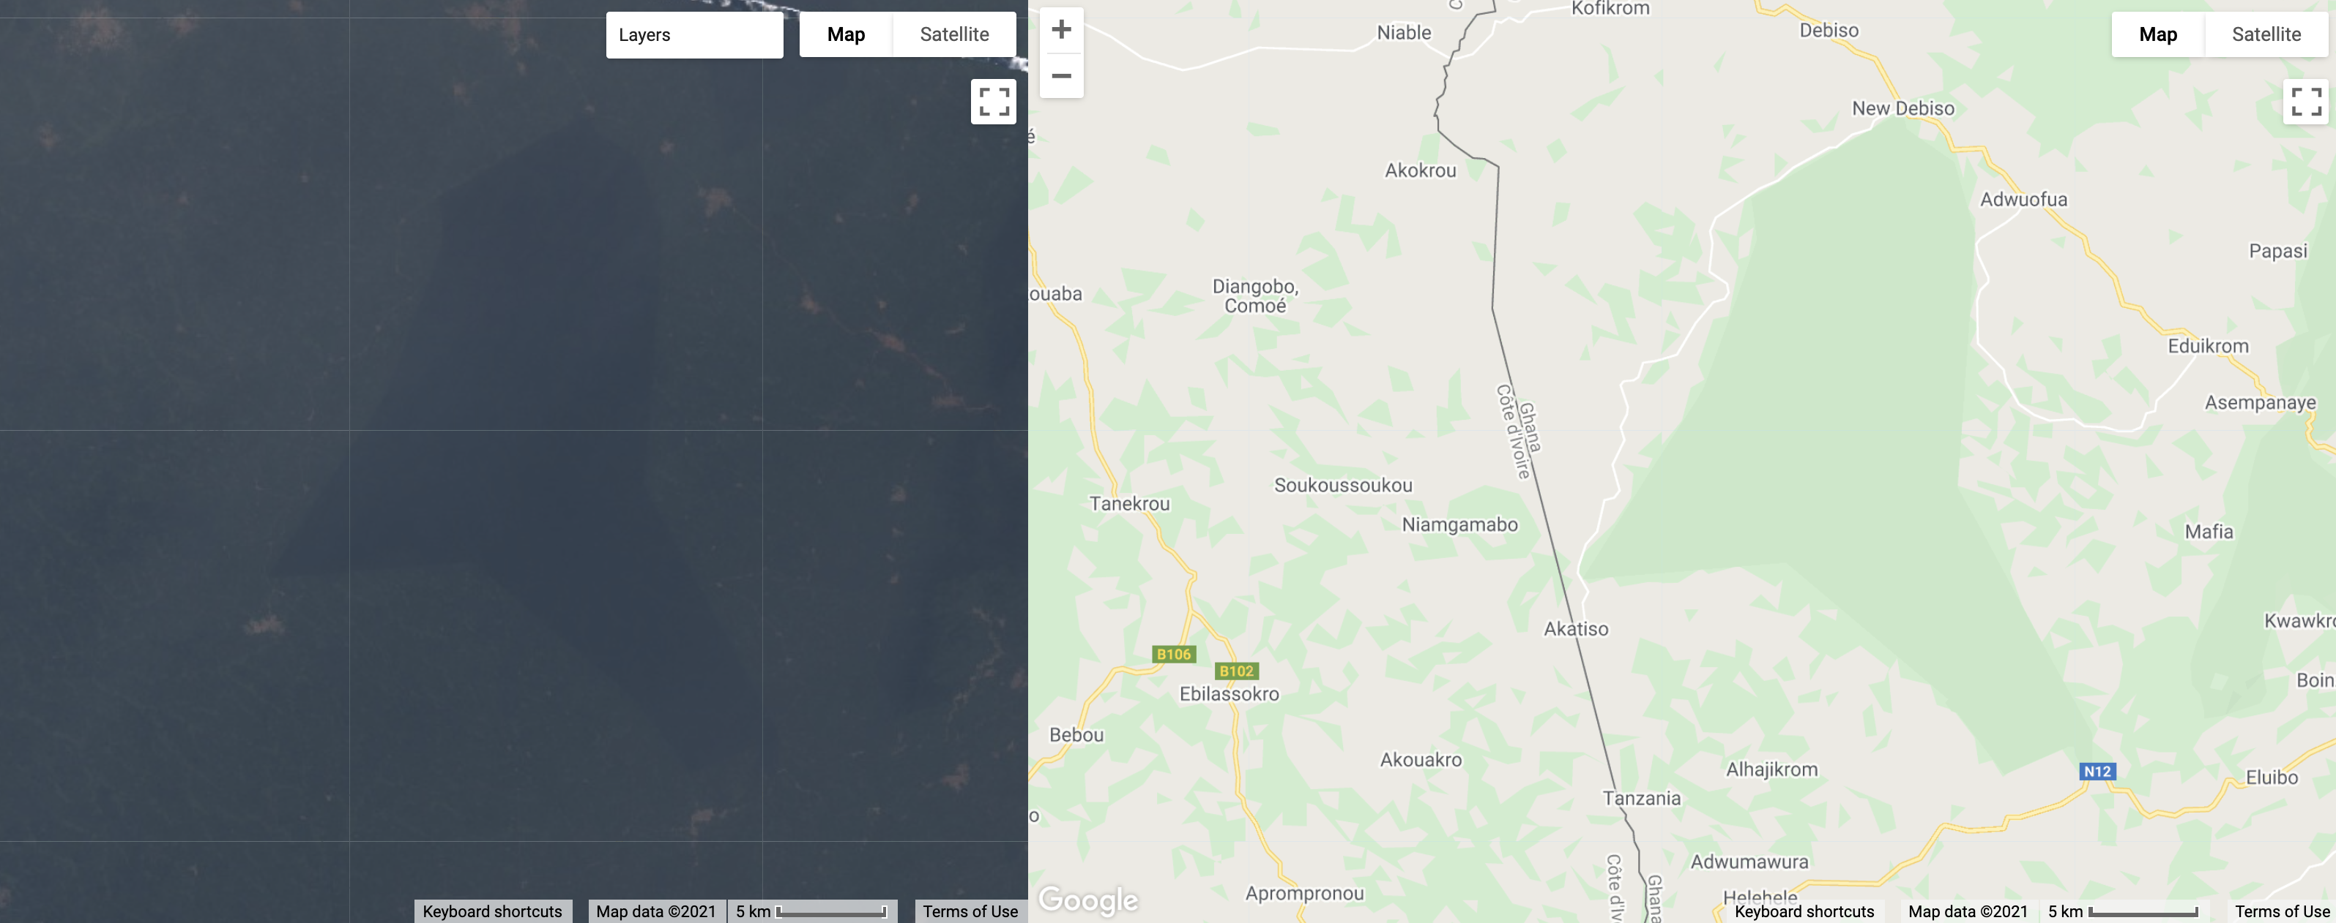
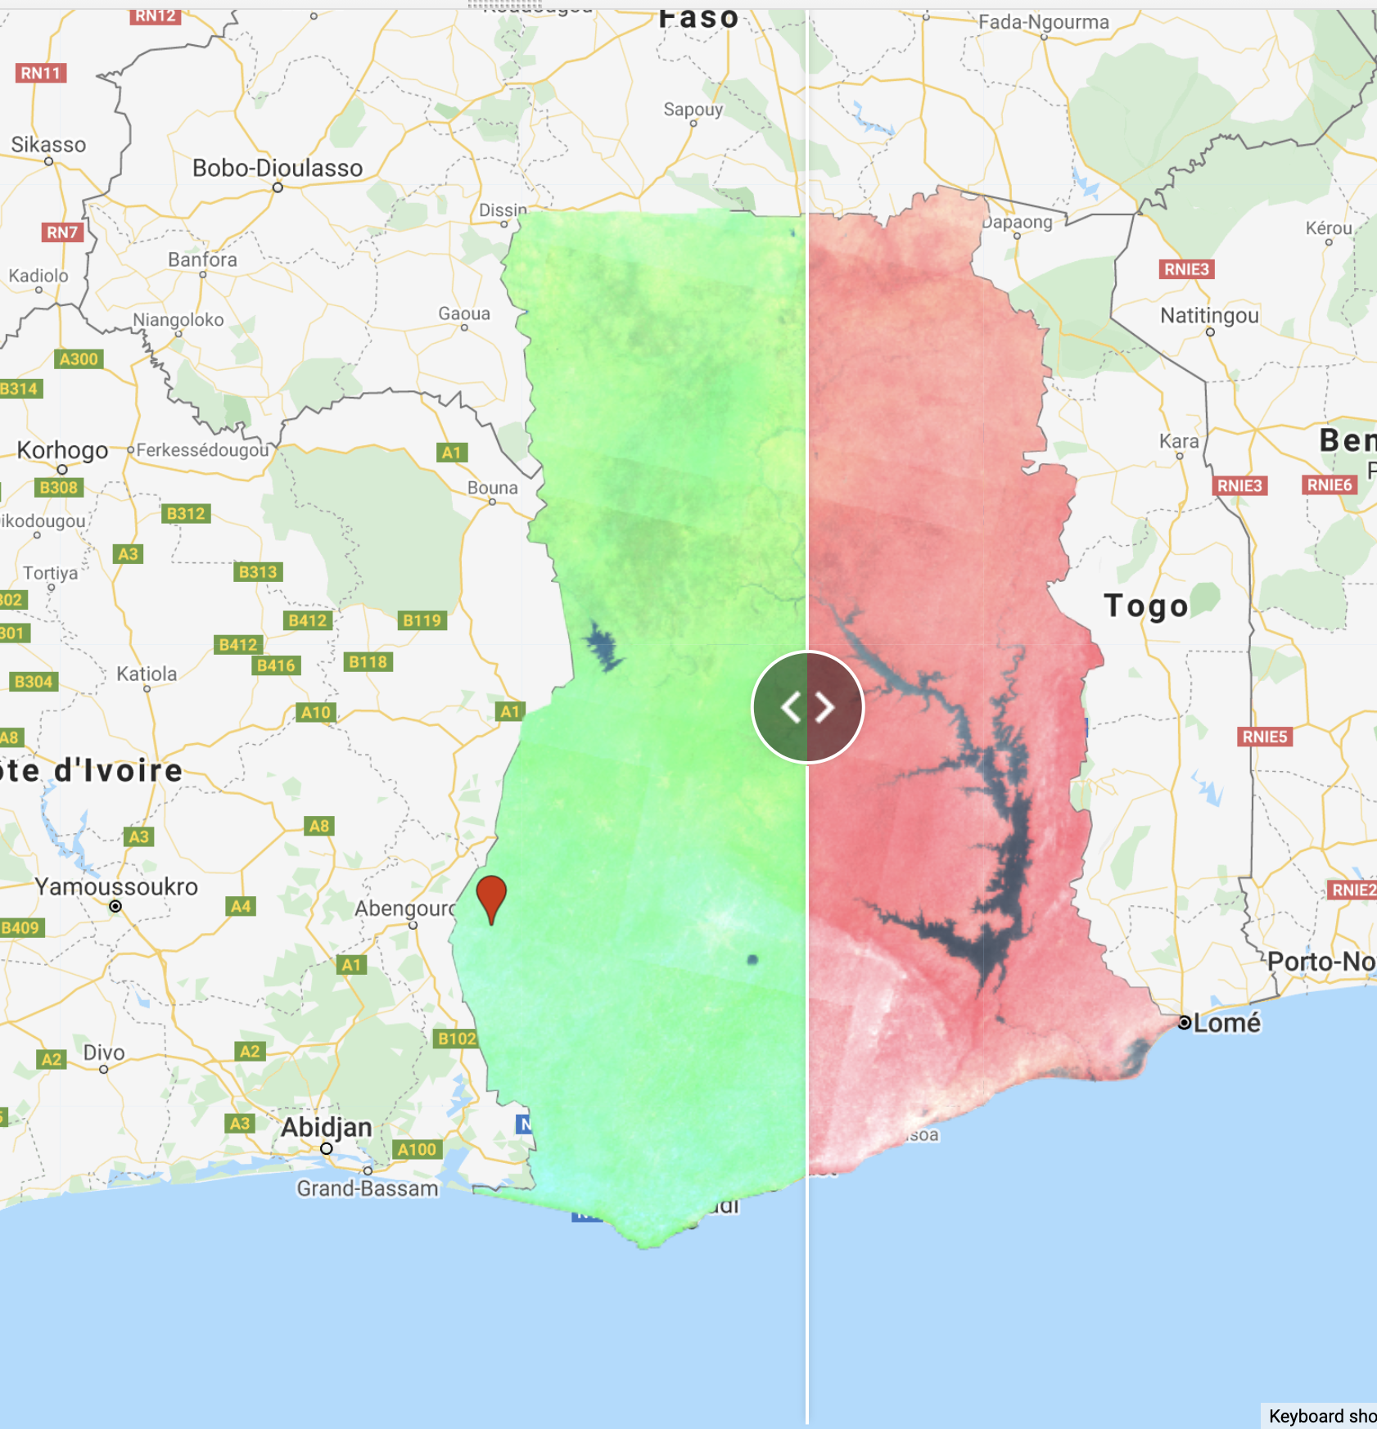
ui.Map.Linker
The linker is not a styleable widget. It is a behind-the-scenes utility that can be used to synchronize the movement of multiple ui.Map instances
Run Example
ui.SplitPanel
A ui.SplitPanel is useful for comparing things side-by-side. The advantage of a ui.SplitPanel over two ordinary panels is that a handle can be used to achieve a wipe transition between the panels in a ui.SplitPanel
Run Example

Slide 7
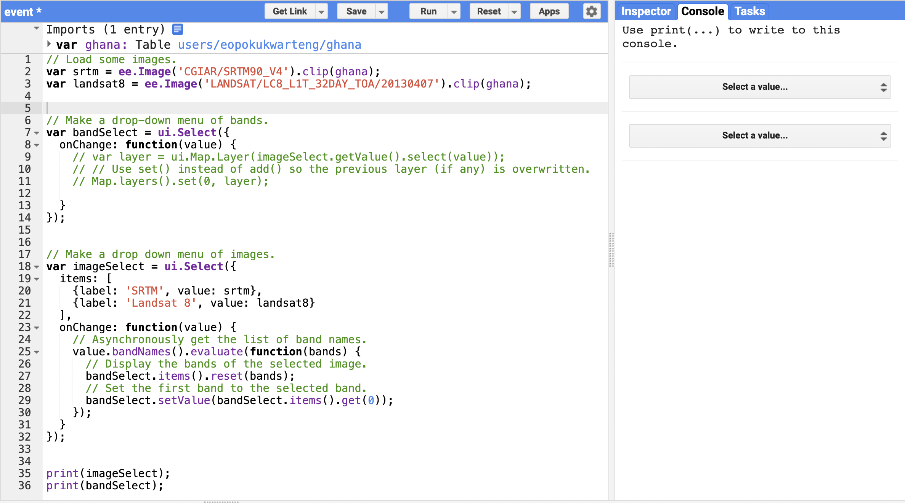
Events
Events are fired by user interaction with a widget or a programmatic change to a widget. To do something when the event occurs, register a callback function on the widget with either onClick() (for ui.Map or ui.Button) or onChange() (everything else).
Run in Code Editor

Slide 8
Panels and Layouts
ui. Panel
A ui.Panel is an upper-level UI container in which to arrange widgets
Each ui.Panel has a ui.Panel.Layout object that controls how its widgets are arranged on the screen
Layouts
Layouts control how widgets in a panel are arranged for display

Slide 9
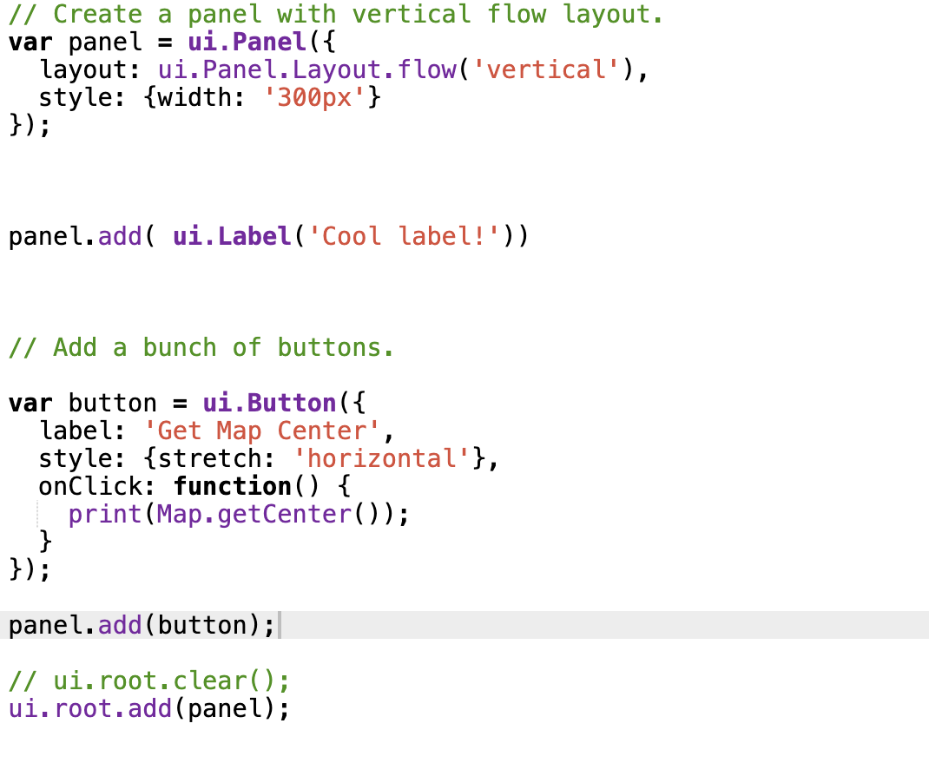
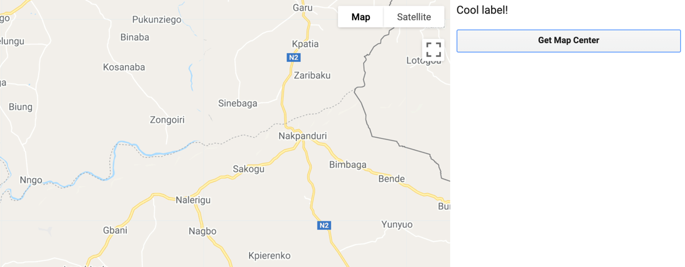
Panels and Layouts
Run in Code Editor

Slide 10
Time-Series Charts
Earth Engine API supports charting functions based on the Google Chart API
Use the ui.Chart.image.series() function to create a time-series chart.
We will apply all the knowledge in the following ;
filter
map
reduce
cloud-masking
Exercise
Create a chart of average NDVI values for a given farm over 1 year.

Slide 11
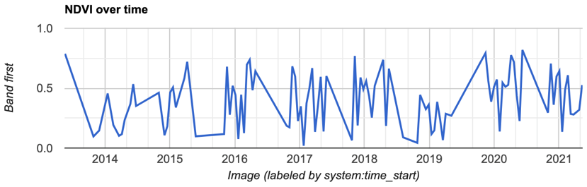
Basic Time Series Analysis
// Import the Landsat 8 TOA image collection.
var l8 = ee.ImageCollection('LANDSAT/LC08/C01/T1_TOA');
// Map a function over the Landsat 8 TOA collection to add an NDVI band.
var withNDVI = l8.map(function(image) {
var ndvi = image.normalizedDifference(['B5', 'B4']).rename('NDVI');
return image.addBands(ndvi);
})
// Create a chart.
var chart = ui.Chart.image.series({
imageCollection: withNDVI.select('NDVI'),
region: roi,
reducer: ee.Reducer.first(),
scale: 30
}).setOptions({title: 'NDVI over time'});
// Display the chart in the console.
print(chart);
Run in Code Editor

Slide 12
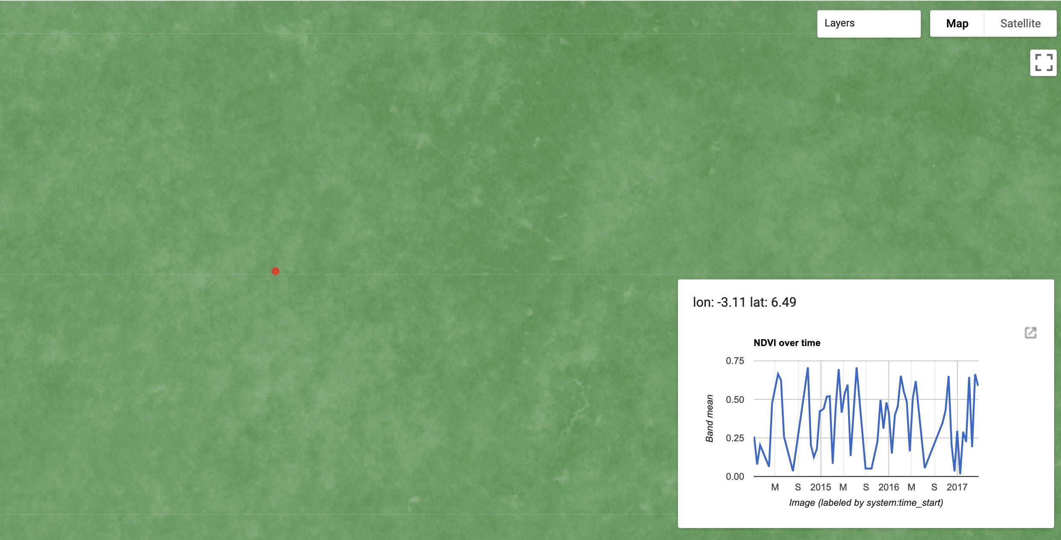
Creating an Interactive Time Series App
Enter Code Editor
Run in Code Editor

Slide 13
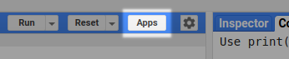
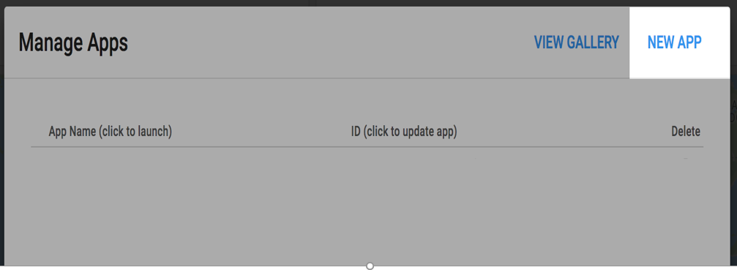
Publishing your App - 1
To publish an App from the Code Editor:
First load the script that you want to make into an App
Open the App Management panel, which you can access by clicking the Apps button above the script section in the Code Editor
Click on the NEW APP button
In the dialog, choose an App name, select a Google Cloud Project, and specify the location of the App's source code

Slide 14
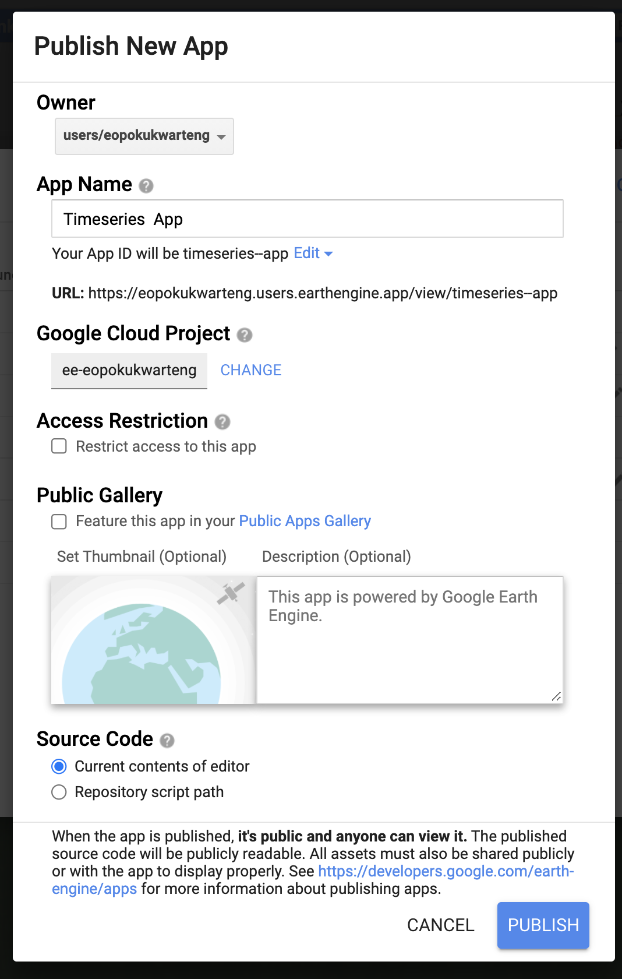
Publishing your App - 2
When all fields are filled out and validated, the PUBLISH button will be enabled
Click the button to complete publishing

Slide 15
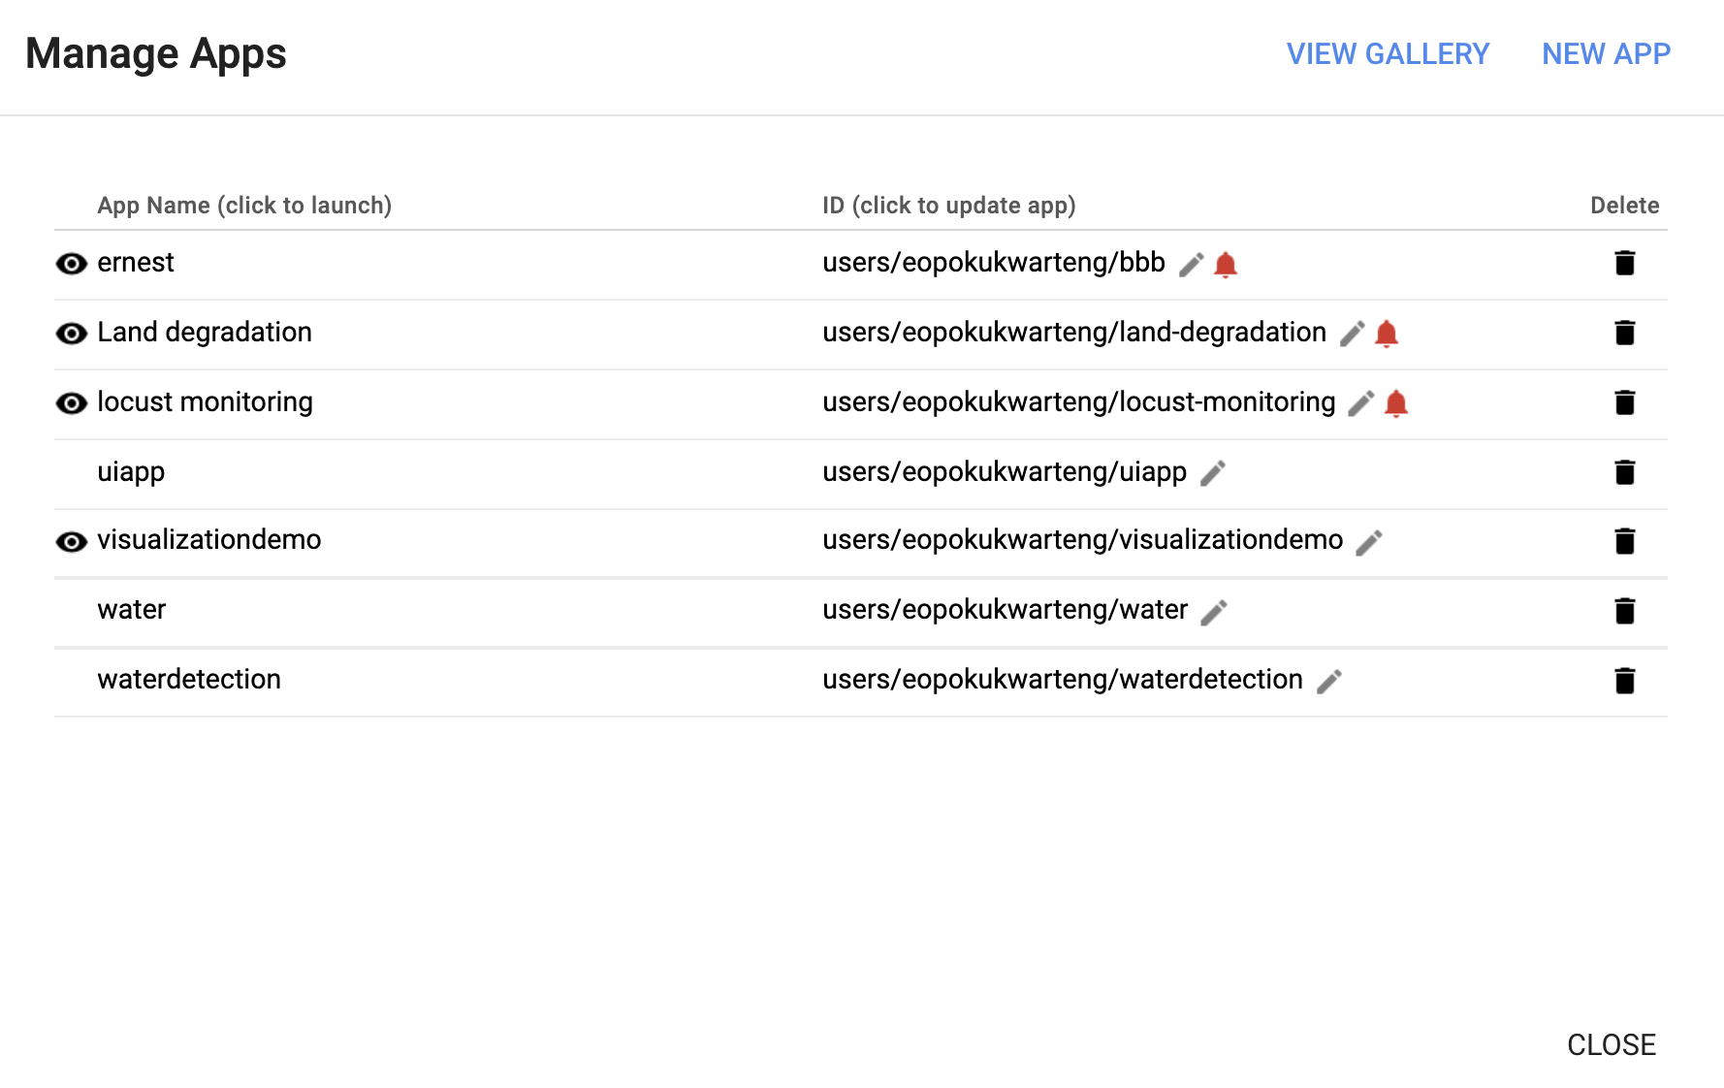
Managing your Apps
To manage an App from the Code Editor:
Open the App Management panel by clicking the Apps button above the script section in the Code Editor.
Update the App's configuration
Or delete the App

Slide 16




Thank You
Accra, Ghana
September, 2021
Notes:
It's free for non-commercial use!

